Slide 1



CISC3003 Web Programming
UM’S BICYCLE RENTAL MANAGEMENT SYSTEM
TEAM 01
dc325182 – Che Chi Hin
dc325420 – Chang I Wai
dc325381 – Hoi Kai Cheng
dc325107 – Ho Weng Hong
dc325095 – Chung Hou Sam
dc325837 – Lei Man Lam
Pair 07
Pair 09
Pair 14

Slide 2
TABLE OF CONTENT
07
Division of Work
01
Context
08
Contributions
02
Goals & Objectives
(BPMN,C4, UML)
09
Criteria of Success
03
Services & Requirements
10
Evaluation
04
Tasks
11
Learning (Individual) (Team)
05
Challenges
12
Declaration of AI Usage
06
Deliverables
13
Reference

Slide 3

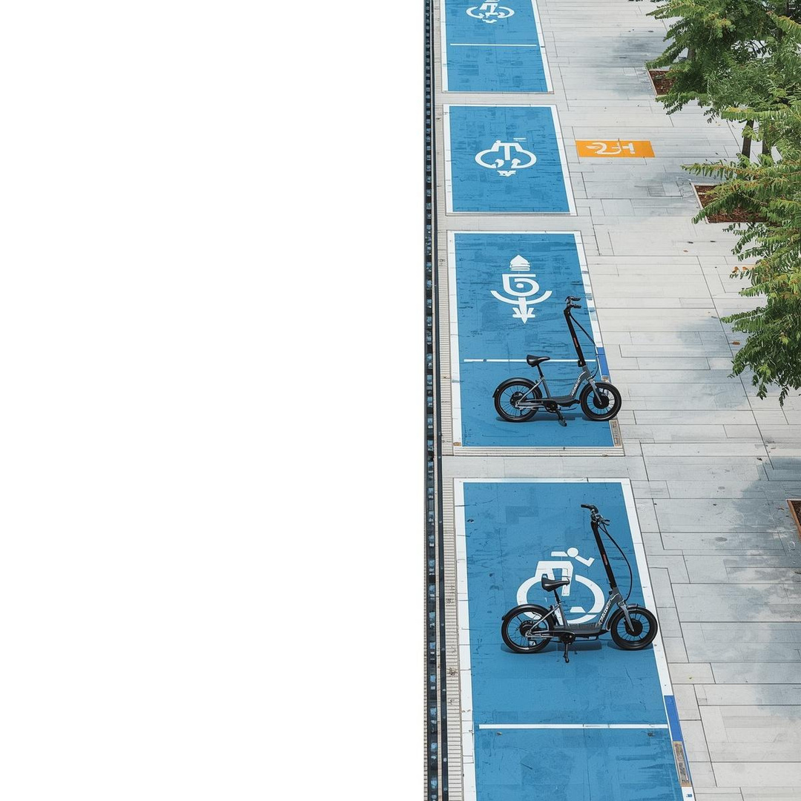

CONTEXT
Background
The University of Macau (UM) campus is large, making walking between buildings time-consuming and resulting in informal, disorganized bicycle usage.
Web Application Architecture
Frontend → HTML, CSS, and JavaScript
Backend → PHP, running on a local XAMPP server environment,
InfinityFree (Free Web Hosting)
Database → MySQL in InfinityFree
Speaker: dc325381 – Hoi Kai Cheng

Slide 4


GOALS
Primary Objective
provide a convenient "last-mile" transport option
helps users move efficiently across the campus
System Goals
Design a platform (register/log in/manage rental accounts)
core operations → searching, renting, returning, and viewing history.
administrators → manage vehicles, stations, and accounts
Speaker: dc325381 – Hoi Kai Cheng

Slide 5
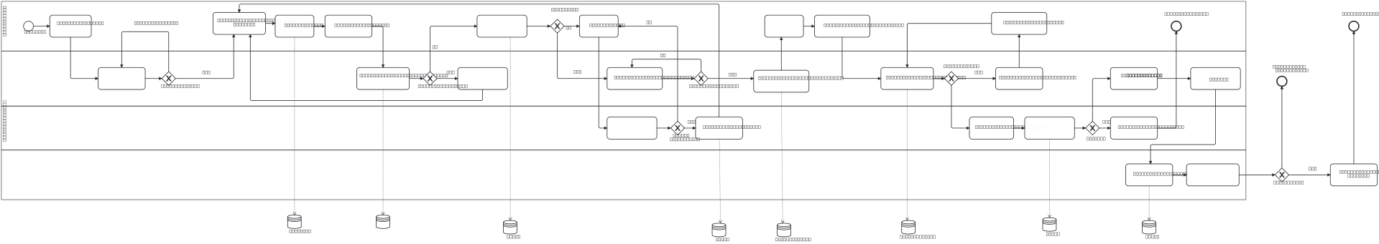
BPMN
Speaker: dc325381 – Hoi Kai Cheng

Slide 6
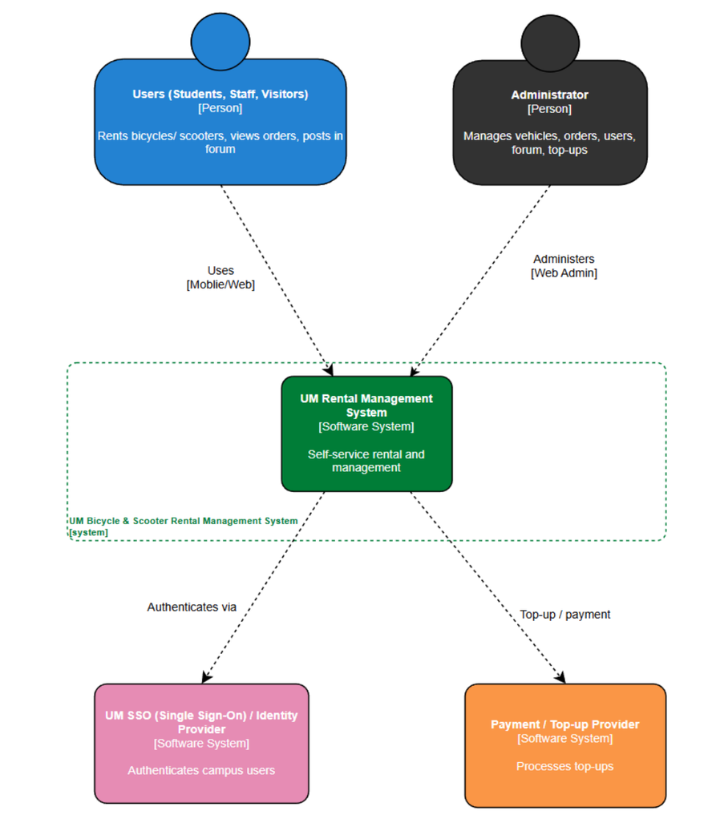
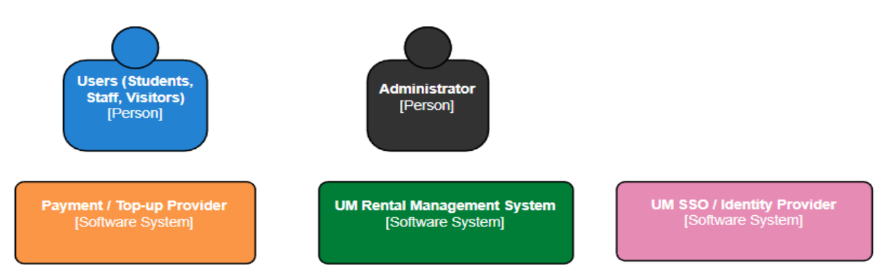
SYSTEM CONTEXT DIAGRAM
Speaker: dc325381 – Hoi Kai Cheng

Slide 7
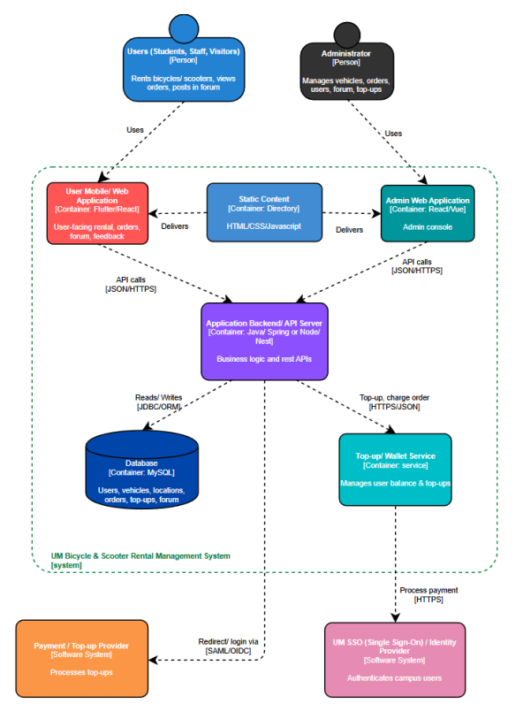
This diagram showcases the high-level architecture, showing how the PHP Backend connects the Frontend to the MySQL Database.
Speaker: dc325381 – Hoi Kai Cheng

Slide 8
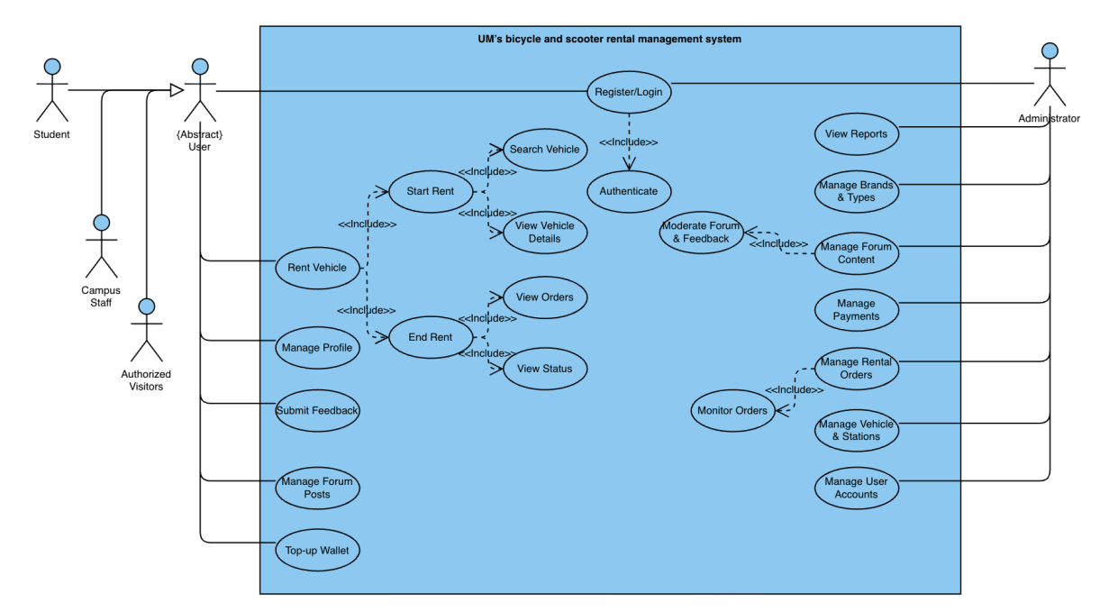
Speaker: dc325107 – Ho Weng Hong
This diagram maps out the full functional scope for both Campus Users and Administrators.

Slide 9
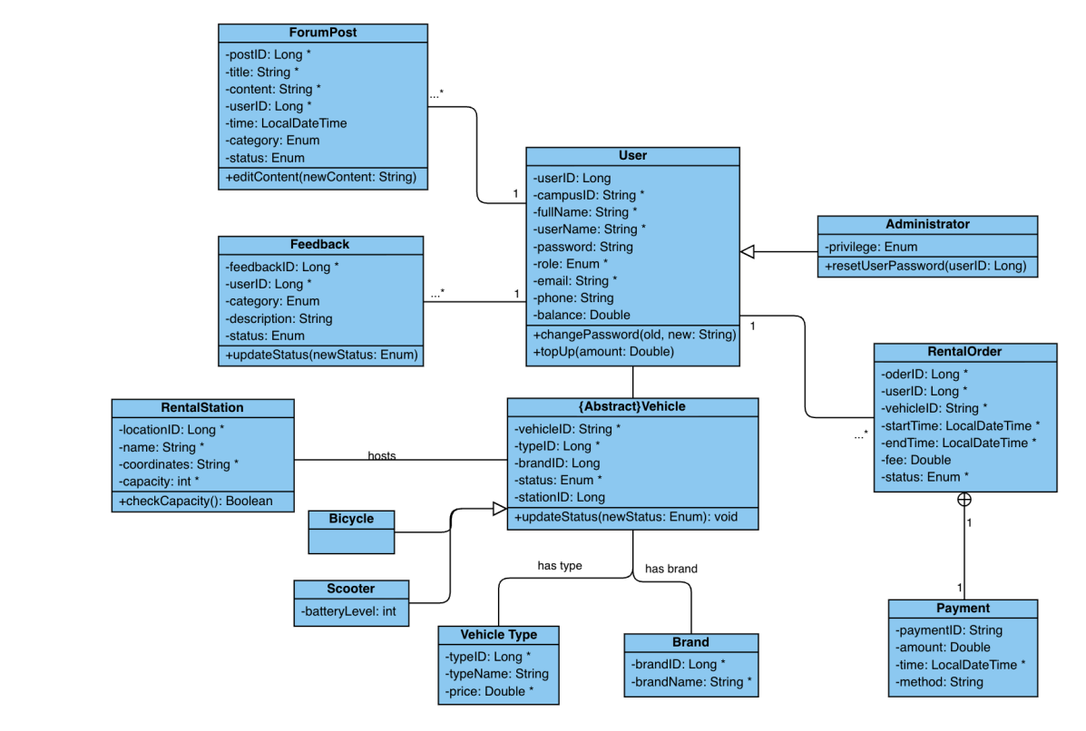
Speaker: dc325107 – Ho Weng Hong
This diagram defines the database entities and their relational attributes to ensure data normalization.

Slide 10
SERVICES AND REQUIREMENTS
Data Requirements (Entities)
Users
Vehicles & Stations
Rental Orders
ID, Role, Email, Balance.
Vehicle Status, Type, Location Coordinates, Capacity Limits.
Start/End times, Fees, Status.
Speaker: dc325107 – Ho Weng Hong

Slide 11
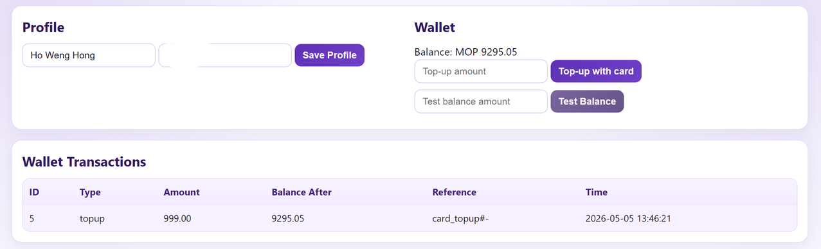
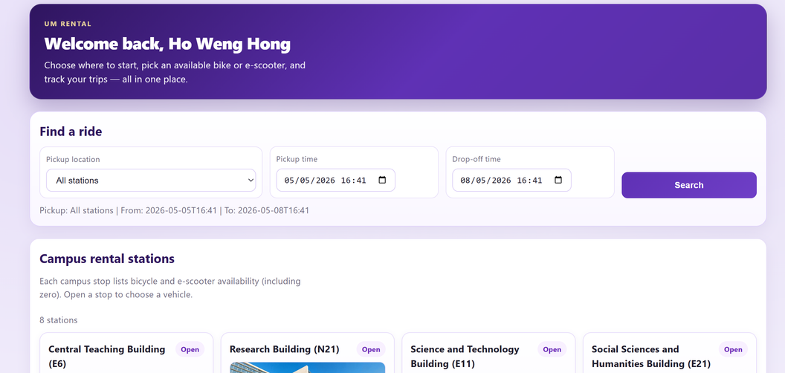
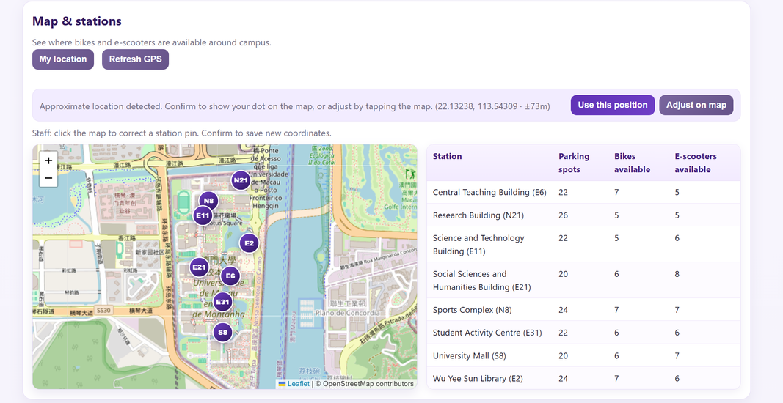
CORE SERVICES (USER)
Account authentication via Google
Profile management
Vehicle search
Click "Rent" on the rental website
Wallet top-up
Interactive campus map integrating Leaflet and OpenStreetMap
Speaker: dc325107 – Ho Weng Hong

Slide 12
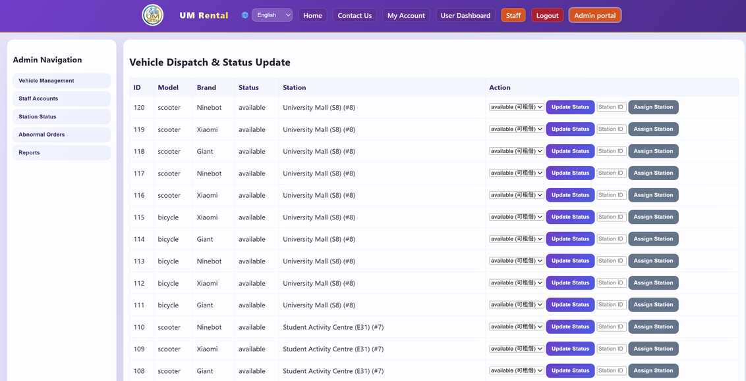
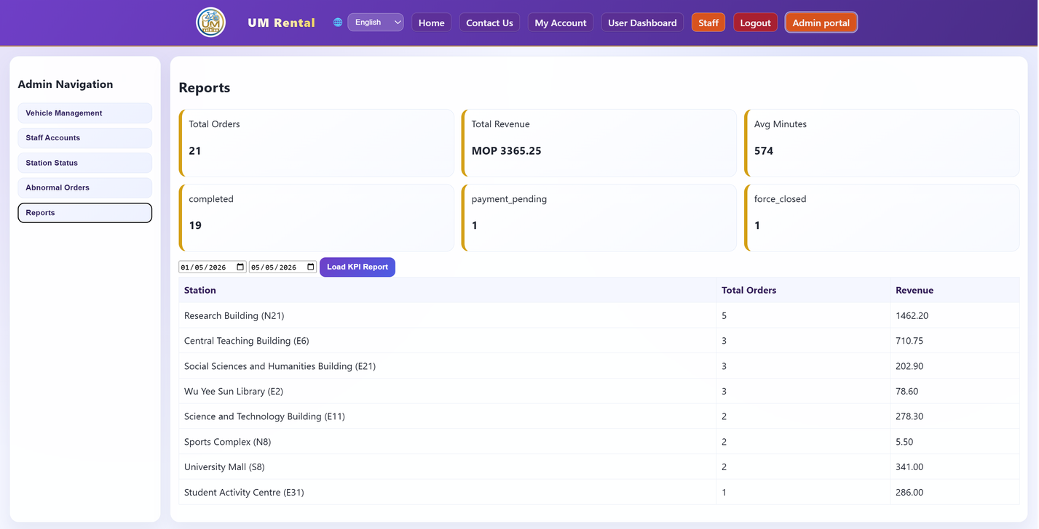
CORE SERVICEs (Admin)
Inventory management (add/retire vehicles)
Station capacity control
Manual order adjustments
Forum moderation
Speaker: dc325107 – Ho Weng Hong

Slide 13





PROJECT TASKS
Project Planning and UI/UX Design, including finalizing the proposal and visual layouts.
PHASE 1
Front-End Development, translating designs into HTML/CSS/JS and building core rental interface workflows
PHASE 2
Back-End Integration, configuring XAMPP/MySQL and writing PHP scripts for authentication, fee calculation, and real-time status updates
PHASE 3
PHASE 4
System Testing and Deployment via InfinityFree
Speaker: dc325182 – Che Chi Hin

Slide 14
CHALLENGES
STATE MANAGEMENT
CAPACITY CONSTRAINTS
SECURITY
Accurately tracking vehicle statuses (Available, Rented, Maintenance)
preventing multiple active rentals simultaneously
Implementing logic
preventing ending a rental at a station
and exceeded its maximum vehicle capacity
password hashing
role-based access control
(users/ administrators)
Speaker: dc325420 – Chang I Wai

Slide 15

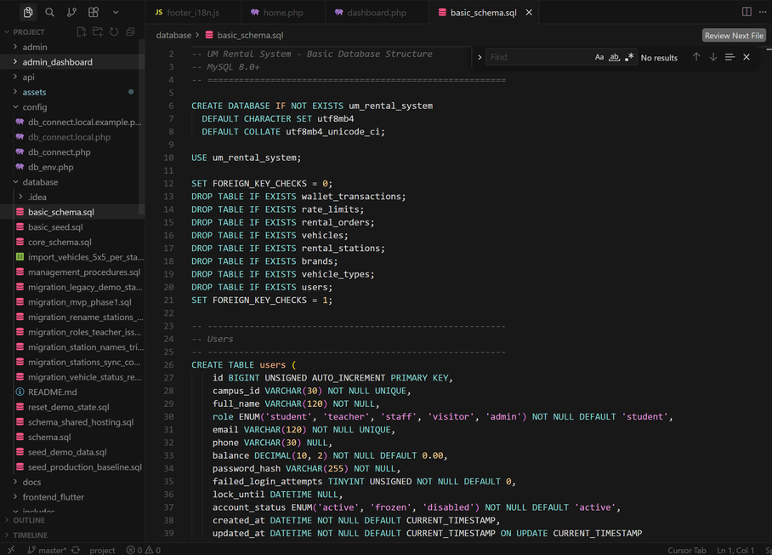


DELIVERables
A fully functional, full-stack web application hosted on InfinityFree.
A complete Full website source code (HTML, CSS, Javascript, PHP)
Database script, content & EER
(Enhanced ER Diagram)
UML/BPMN diagram
Speaker: dc325420 – Chang I Wai

Slide 16
DIVISION OF WORK AMONG TEAM MEMBERS
Pair 09
Hoi Kai Cheng & Ho Weng Hong
Backend architecture, PHP scripting, and MySQL database design
Pair 07
Che Chi Hin & Chang I Wai
Frontend UI/UX design, responsive HTML/CSS layouts, and JavaScript interactions
Pair 14
Chung Hou Sam & Lei Man Lam
System testing, UML documentation, admin portal services, and GitHub version control management
Speaker: dc325095 – Chung Hou Sam

Slide 17
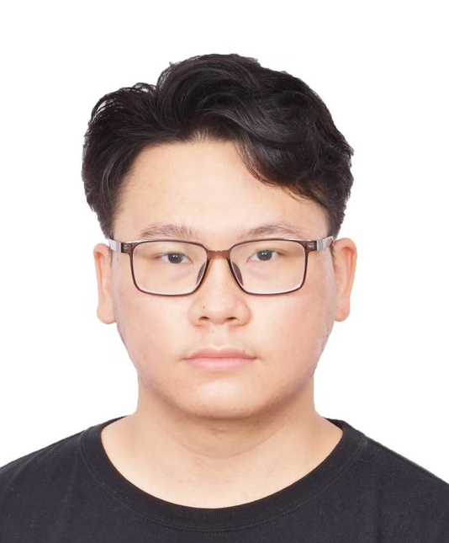

CONTRIBUTIONS FROM TEAM MEMBERS
Hoi Kai Cheng
Ho Weng Hong
Team Leadership, Core Backend/Database Architecture, Deployment setup.
Staff & Admin Portal Logic, Role-based Access Control.
Speaker: dc325095 – Chung Hou Sam

Slide 18

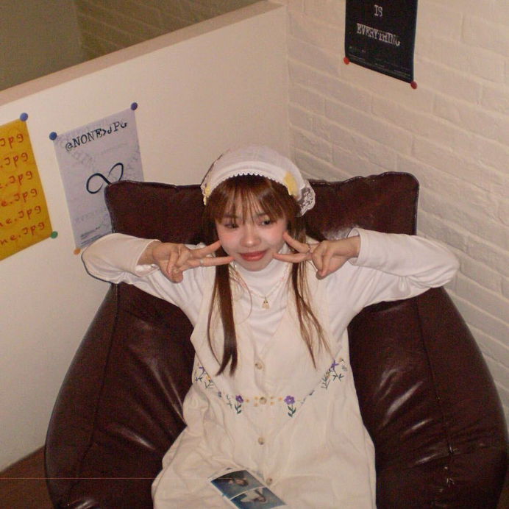
CONTRIBUTIONS FROM TEAM MEMBERS
Che Chi Hin
Chang I Wai
Frontend UI/UX Redesign, Modal implementations.
Leaflet Map API Integration, Geolocation logic.
Speaker: dc325095 – Chung Hou Sam

Slide 19


CONTRIBUTIONS FROM TEAM MEMBERS
Chung Hou Sam
Lei Man Lam
Database Schema design, Migrations, Seed Data.
i18n Multi-language Integration, Documentation and successfully deployed the final system platform
Speaker: dc325095 – Chung Hou Sam

Slide 20

CRITERIA OF SUCCESS
Performance
System supports 50 concurrent users with < 2 seconds response time for standard operations
Reliability
Preserves committed database transactions (start/end rentals) even during unexpected failures
Functionality
over lots of the core modules (Signup, Login, Dashboard, Rental Workflows) operate without critical bugs
Speaker: dc325095 – Chung Hou Sam

Slide 21
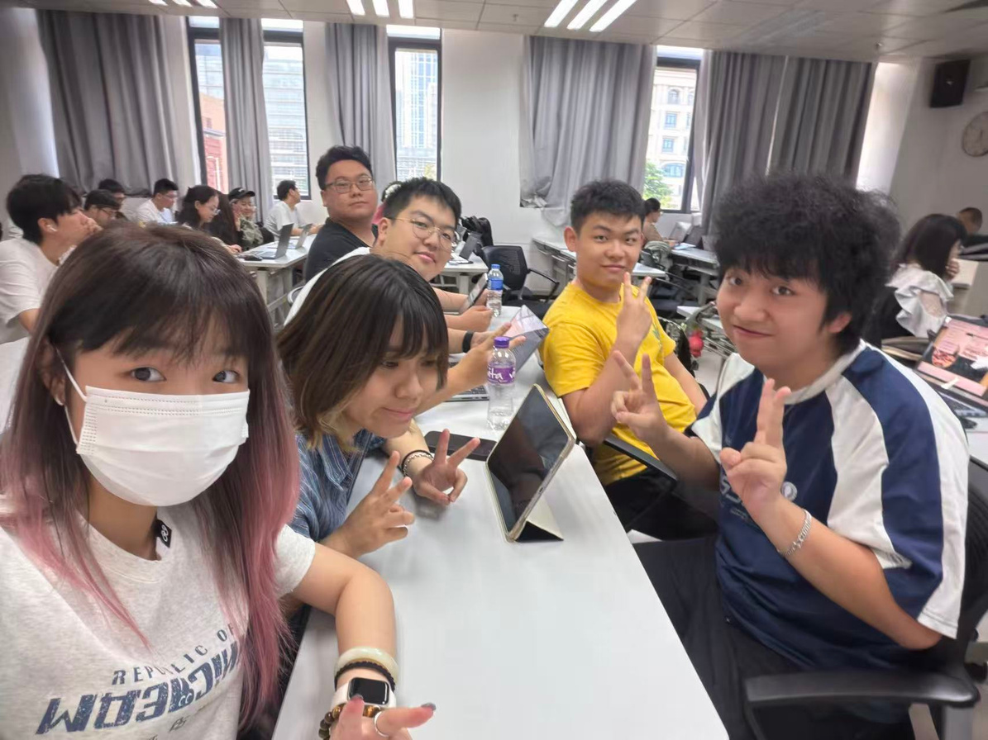
CONTRIBUTIONS FROM TEAM MEMBERS
HO WENG HONG
Che Chi Hin
Hoi Kai Cheng
Chung Hou Sam
Chang I Wai
Lei Man Lam
Speaker: dc325095 – Chung Hou Sam

Slide 22


LIVE SYSTEM DEMO
https://cisc3003team01.gt.tc
Speaker: dc325095 – Chung Hou Sam

Slide 23




Speaker: dc325837 – Lei Man Lam
PROJECT EVALUATION
System Testing Validation
Passing all predefined test cases
(e.g., preventing rentals at full stations, successful timeout logouts)
Instructor Assessment
Successful demonstration of the deployed Web URL
Improving the integration of the frontend and backend modules

Slide 24


Speaker: dc325837 – Lei Man Lam
PROJECT LEARNING
INDIVIDUAL LEARNING
Mastering specific technical stacks (HTML, CSS, PHP, SQL) and understanding software engineering principles like UML modeling and requirement specification
TEAM LEARNING
utilizing GitHub for collaborative version control, and conducting structured strategic meetings

Slide 25

DECLARATION OF AI USAGE
AI Tool: Google Gemini.
Application: Documentation refinement, proposal structuring, and code logic troubleshooting.
Review: All content verified and adapted by the team to ensure academic integrity.
Speaker: dc325837 – Lei Man Lam

Slide 26
REFERENCES (APA STYLE)
Chonoles, M. J., & Schardt, J. A. (2003). UML 2 for dummies. Wiley.
Mozilla. (2025). MDN Web Docs: Responsive Web Design.
https://developer.mozilla.org/en-
US/docs/Learn_web_development/Core/CSS_layout/Responsive_Design
Seidl, M., Scholz, M., Huemer, C., & Kappel, G. (2015). UML @ Classroom: An
introduction to object-oriented modeling. Springer.

Slide 27
THANK YOU
Any Questions?

